Slide 1
Technical Guide
May. 2012

Slide 2
xPrintServer Network Edition:As small as an iPhone
Clean, elegant form factor
Lantronix-branded (slightly raised)
With “x” that glows Lantronix orange
SIMPLE to connect, use and monitor
External (universal) power supply
Red / green LEDs for RJ45 jack

Slide 3
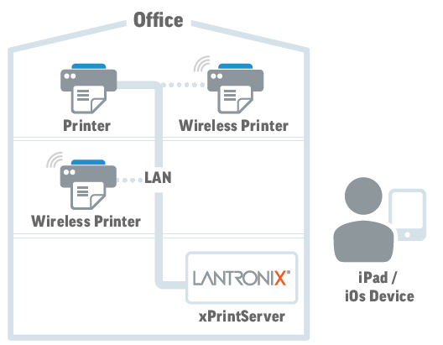
Technical Overview
1. xPrintServer supports DHCP
2. After connecting xPrintServer
to the network, xPrintServer will
get IP address from DHCP server
3. xPrintServer queries your
network printers using SNMP
4. Discovered printers are
added to the printer list
5. xPrintServer connects to the
Internet to retrieve printer
drivers
Connect anywhere to your network (auto discovers / provisions printers on the subnet)*
* For best performance, we recommend one (1) xPrintServer for every 7-10 printers on each subnet

Slide 4
Troubleshooting Guide

Slide 5
I can’t find my xPrintServer!!
URL: “xprintserver.local” doesn’t work!
Bonjour port is disabled within network
Check the DHCP table from the DHCP server
go to www.lantronix.com/findmyxprintserver
Enter in serial number and we’ll discover your xPrintServer!

Slide 6
Printer in the Printer List why cannot print??
Test page not succeeded?
IOS device report errors after sending print?
Answer: Even the printer list in the printer List, it doesn’t means the printer driver is being loaded into XprintServer!! Or loaded a wrong driver!!
xPrintServer can’t retrieve drivers
Check Internet access (outbound port 80)
Outbound connections blocked

Slide 7
Auto Discovery – Wrong Printer Driver Loaded

Slide 8
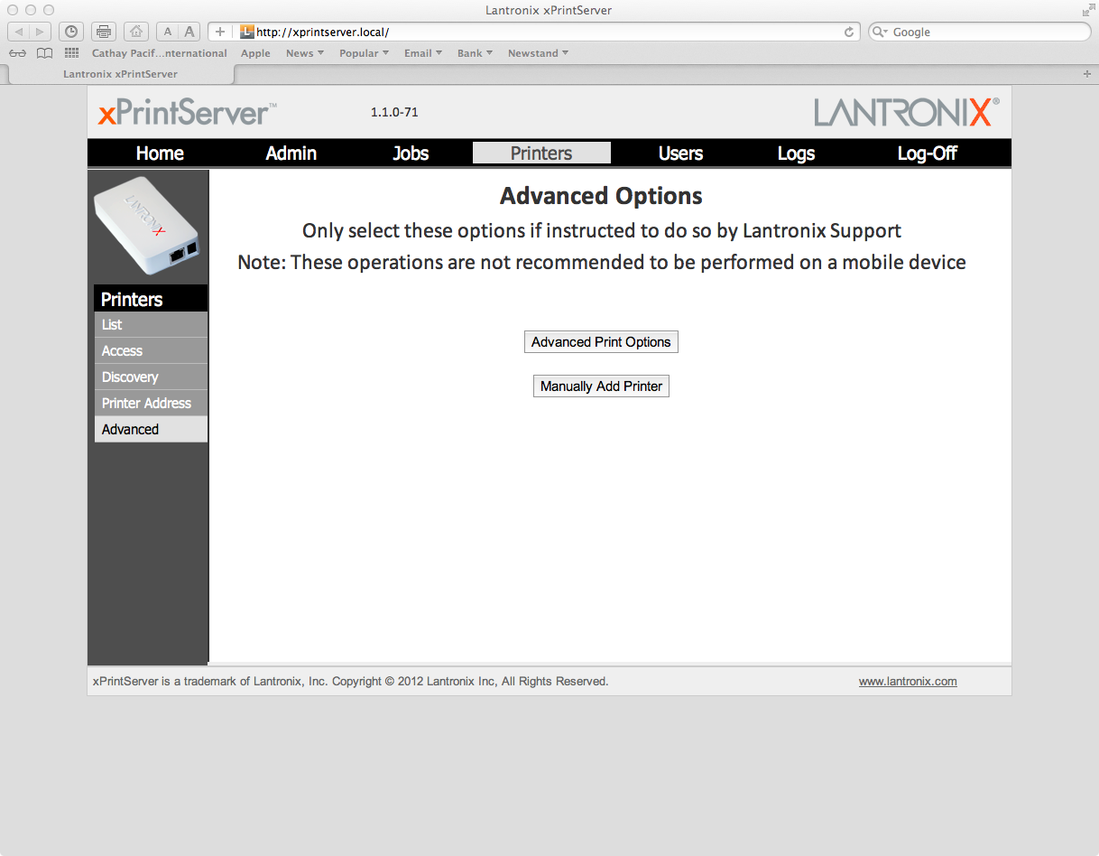
Manually Add Printer – Select the right Printer Driver

Slide 9
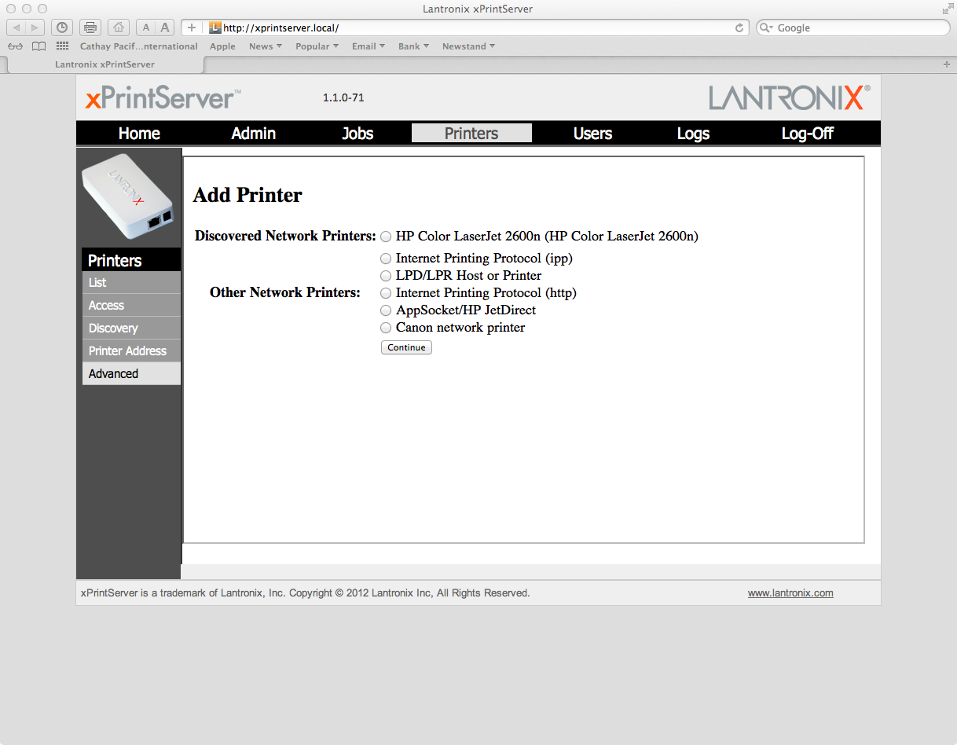
Add Printer – Discovered / other Printer Protocol

Slide 10
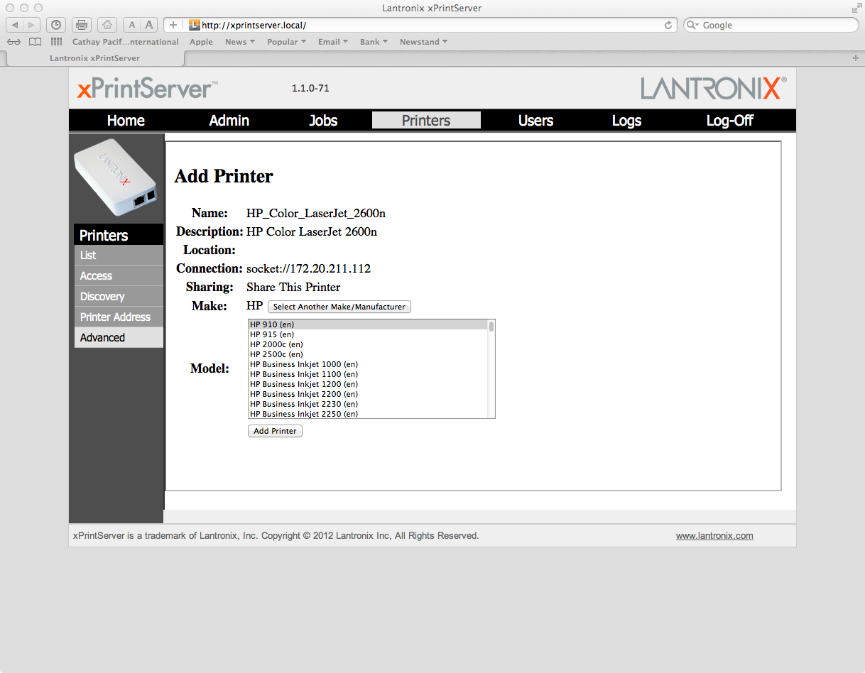
Select the right printer driver

Slide 11
If your iOS device doesn’t see provisioned printers:
It may be blocked by firewalls
Open port UDP 5353 (bonjour port)
Check Multicast setting within the routers

Slide 12
Air Print Requirement – Router Sonic Wall –SonicOS

Slide 13
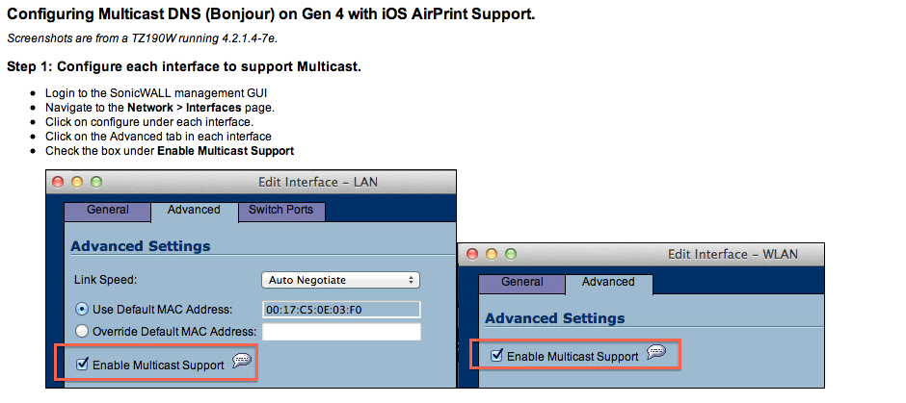

Slide 14
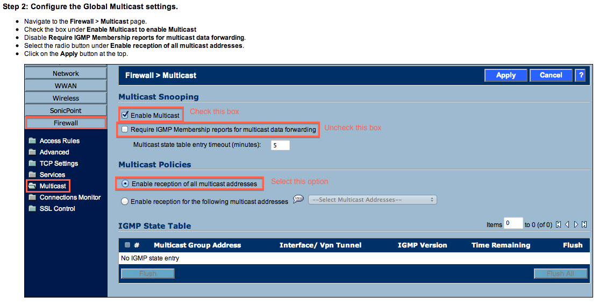

Slide 15
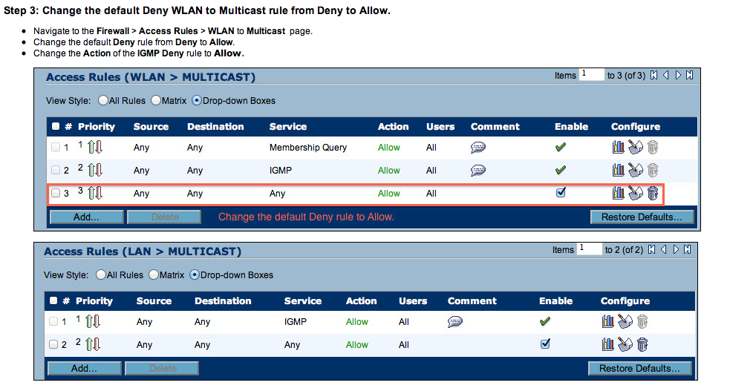

Slide 16
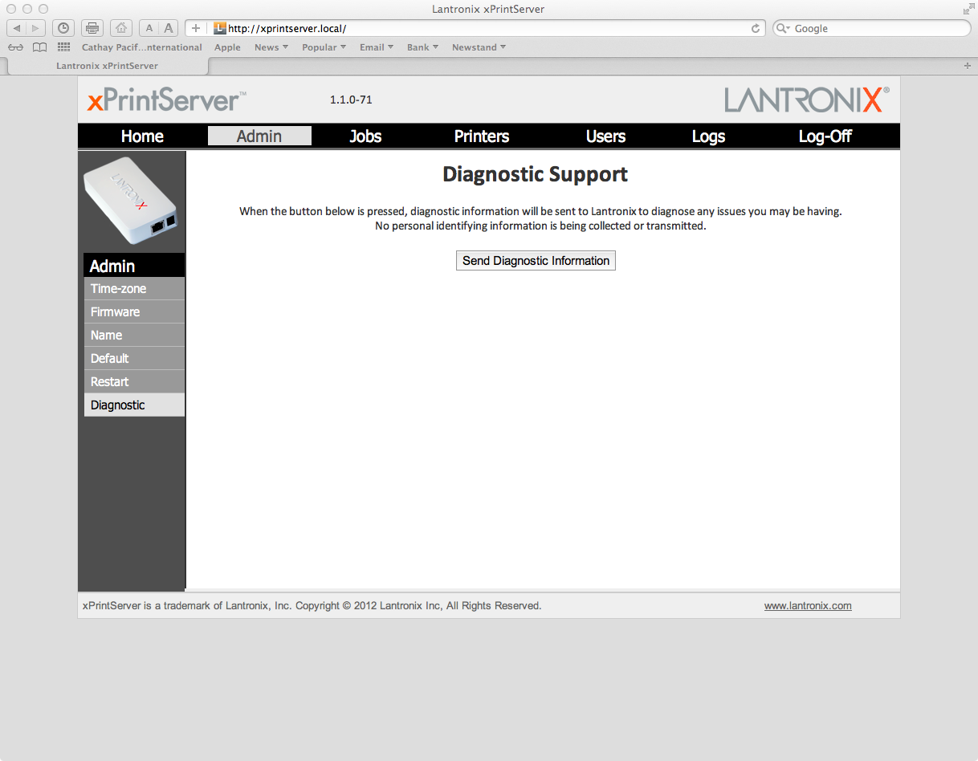
Still No Hope??
Send Diagnostic In formation to our support team.

Slide 17
Don’t see your printer listed?
Request to add your printer
http://www.lantronix.com/info/xprintserver/add-my-printer/

Slide 18
FW version 1.1.0-64 to 1.1.0-71
KNOWN ISSUES
==========
1) Using the Print Test Page action in the Printers menu may fail for high resolution printers.
2) Downgrading from a Beta version to a Production version of firmware may cause device
configuration to be lost.
3) xPS Release 1.1.0 will support Firmware downgrade from any installed None Production builds
(Internal167 and Beta761) to what is currently running as the latest on the xPS Production
Firmware Web Site.
Downgrading from a Beta version to a Production version requires the browsers cache to be cleared
If the xPrintServer has firmware 1.0.0-64 loaded, the updated version information reported by Check Firmware Update process is shown incorrectly (it shows 1.0.0-64). Continue with the upgrade procedure and the unit will be upgraded to 1.1.0-R71
Release Note Link:
http://ltxfaq.custhelp.com/app/answers/detail/a_id/1724

